Slide 1
ALTERNATIVE R&B FOR ME:
A SONG RECOMMENDATION SYSTEM
Danielo Bennett

Slide 2
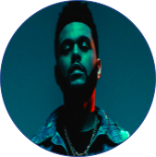
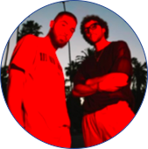
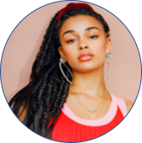
WHAT IS ALTERNATIVE R&B?
A catch all genre that including influences from electronic, ambient and alternative indie music, as well as dubstep and some hip-hop and applies them to the themes of contemporary r&b.
The Weeknd
Majid Jordan
Jorja Smith
Notes:
KEEP TO 20 SECS
Key attributes are a lo-fi yet richly textured sound, ample use of atmospheric synths, occasional samples from indie music and thoughtful, often dark, philosophical lyrics

Slide 3
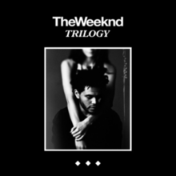
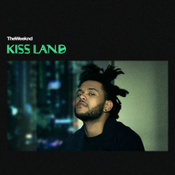
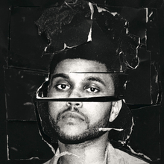
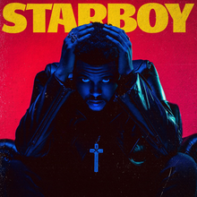
WHY BUILD A RECOMMENDATION SYSTEM?
Alternative-r&b can be a very varied genre making it difficult to navigate when you know what kind of songs you like.
Across the board, artists rarely sound the same & even songs by a single artist can differ in sounds and styles.
Purpose of project: Create a recommendation system that recommends songs from the genre based on either lyrical similarity OR audio signal similarity.
Notes:
SHOULD BE MAX 25 SECS

Slide 4





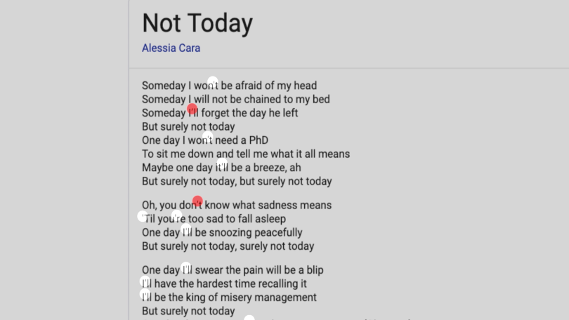
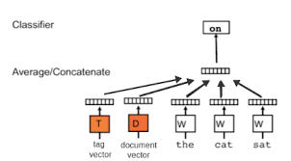
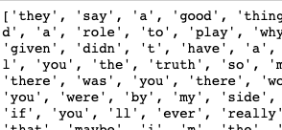
METHODOLOGY - LYRICAL
Cleaning & Transforming
Data Acquisition
Modeling
Productionization
Doc2Vec

Slide 5




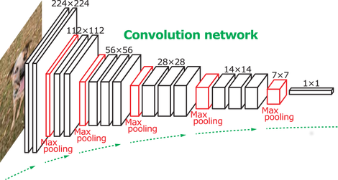
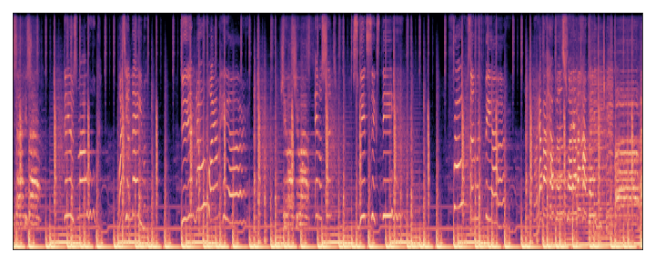
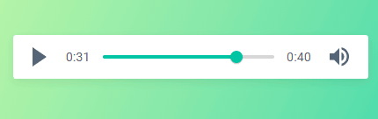
METHODOLOGY - AUDIO
Cleaning & Transforming
Data Acquisition
Modeling
Productionization

Slide 6
FINAL DATASET
Lyrical Component:
About 7500 songs from 141 artists
Removed remixes and redundant copies of songs
Audio Component:
About 150 mp3 files
Extracted 30 sec snippets then transformed to a spectrogram

Slide 7
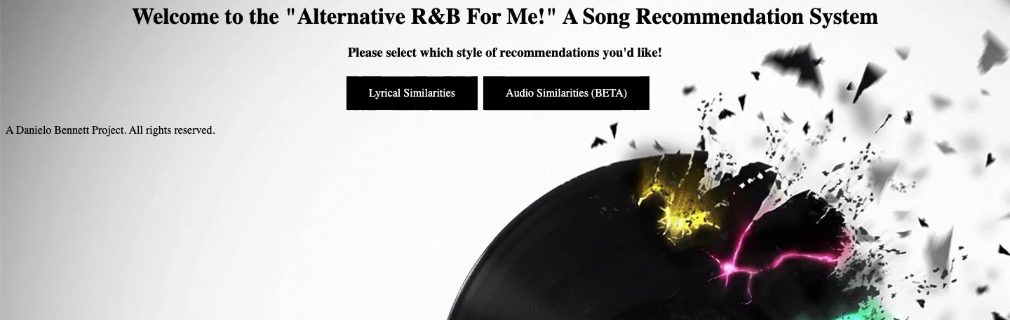
LYRICAL RECOMMENDATIONS
Notes:
Re-record when bring from slides to ppt

Slide 8
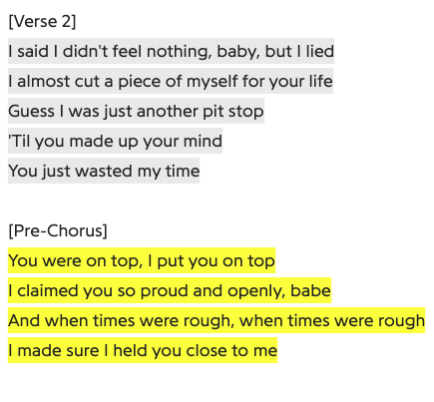
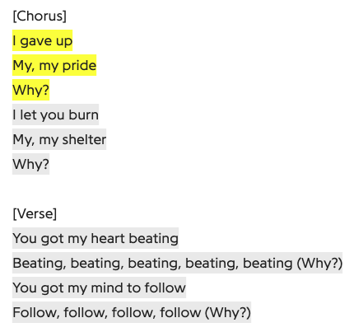
RESULTS - LYRICAL SIMILARITIES
The Weeknd - Call out my name Banks - Fall Over
Notes:
MAybe do 2 examples

Slide 9
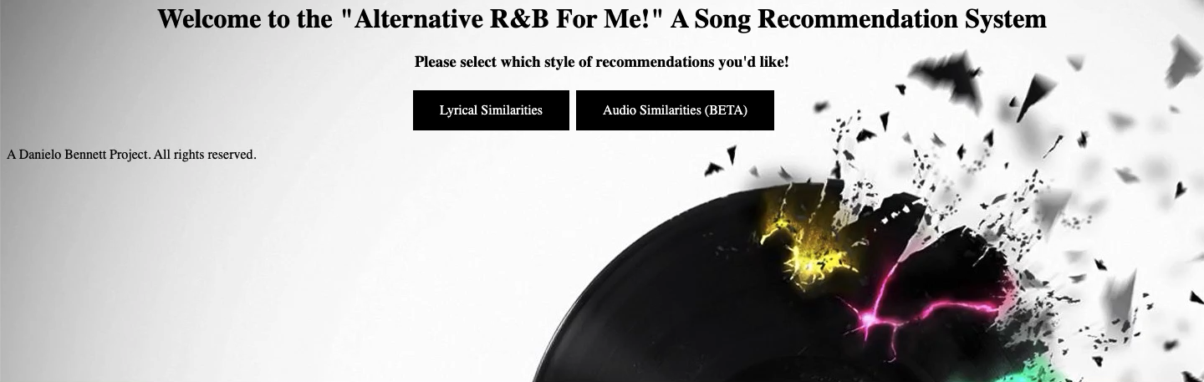

AUDIO SIGNAL RECOMMENDATIONS
Notes:
Play input song. 5-7 sec >. App demo. >. Play output song 5-7 sec
Transition: “As we can notice the similar audio sounds in X, Y, Z way between the songs”

Slide 10




THANK YOU!
Danielo.Bennett1@gmail.com
in/Danielo-bennett
Danielo-B
#RespectTheData
Notes:
#RespectTheData

Slide 11
APPENDIX

